Slide 1
Money Growth and Inflation
© 2015 Cengage Learning. All Rights Reserved. May not be copied, scanned, or duplicated, in whole or in part, except for use as permitted in a license distributed with a certain product or service or otherwise on a password-protected website for classroom use.

Slide 2
Inflation
Inflation
  Increase in the overall level of prices
Deflation
  Decrease in the overall level of prices
Hyperinflation
  Extraordinarily high rate of inflation
© 2015 Cengage Learning. All Rights Reserved. May not be copied, scanned, or duplicated, in whole or in part, except for use as permitted in a license distributed with a certain product or service or otherwise on a password-protected website for classroom use.

Slide 3
Inflation
2002 to 2012
  Prices rose at an average rate of 2.5% per year
The 1970s
  Prices rose by 7.8% per year
  The price level more than doubled over the decade
© 2015 Cengage Learning. All Rights Reserved. May not be copied, scanned, or duplicated, in whole or in part, except for use as permitted in a license distributed with a certain product or service or otherwise on a password-protected website for classroom use.

Slide 4
Inflation
International data, 2012, inflation rate
  2.1% in the U.S
  Negative 0.1% in Japan
  5.1% in Russia
  9.3% in India
  21.1% in Venezuela
February 2008, Zimbabwe
  24,000 percent
© 2015 Cengage Learning. All Rights Reserved. May not be copied, scanned, or duplicated, in whole or in part, except for use as permitted in a license distributed with a certain product or service or otherwise on a password-protected website for classroom use.

Slide 5
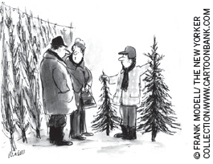
The Classical Theory of Inflation
Classical theory of money
  Quantity theory of money
  Explain the long-run determinants of the price level
  Explain the inflation rate
“So what’s it going to be? The same size as last year or the same price as last year?”
© 2015 Cengage Learning. All Rights Reserved. May not be copied, scanned, or duplicated, in whole or in part, except for use as permitted in a license distributed with a certain product or service or otherwise on a password-protected website for classroom use.

Slide 6
Level of Prices; Value of Money
Inflation
  Economy-wide phenomenon
  Concerns the value of economy’s medium of exchange
Inflation: rise in the price level
  Lower value of money
  Each dollar buys a smaller quantity of goods and services
© 2015 Cengage Learning. All Rights Reserved. May not be copied, scanned, or duplicated, in whole or in part, except for use as permitted in a license distributed with a certain product or service or otherwise on a password-protected website for classroom use.

Slide 7
The Classical Theory of Inflation
Money demand
  Reflects how much wealth people want to hold in liquid form
  Depends on
    Credit cards
    Availability of ATM machines
    Interest rate
    Average level of prices in economy
  Demand curve – downward sloping
© 2015 Cengage Learning. All Rights Reserved. May not be copied, scanned, or duplicated, in whole or in part, except for use as permitted in a license distributed with a certain product or service or otherwise on a password-protected website for classroom use.

Slide 8
The Classical Theory of Inflation
Money supply
  Determined by the Fed and the banking system
  Supply curve is vertical
In the long run
  Overall level of prices adjust
    To the level at which the demand for money equals the supply
© 2015 Cengage Learning. All Rights Reserved. May not be copied, scanned, or duplicated, in whole or in part, except for use as permitted in a license distributed with a certain product or service or otherwise on a password-protected website for classroom use.

Slide 9
Figure 1
How the Supply and Demand for Money Determine the Equilibrium Price Level
Value of
Money, 1/P
Price
Level, P
Money Supply
(high)
1
1
(low)
¾
1.33
A
Equilibrium
value of
money
½
2
Equilibrium
price level
¼
Money
Demand
4
(low)
(high)
0
Quantity fixed
by the Fed
Quantity of Money
The horizontal axis shows the quantity of money. The left vertical axis shows the value of money, and the right vertical axis shows the price level. The supply curve for money is vertical because the quantity of money supplied is fixed by the Fed. The demand curve for money is downward sloping because people want to hold a larger quantity of money when each dollar buys less. At the equilibrium, point A, the value of money (on the left axis) and the price level (on the right axis) have adjusted to bring the quantity of money supplied and the quantity of money demanded into balance.
© 2015 Cengage Learning. All Rights Reserved. May not be copied, scanned, or duplicated, in whole or in part, except for use as permitted in a license distributed with a certain product or service or otherwise on a password-protected website for classroom use.

Slide 10
Effects of a Monetary Injection
Economy is in equilibrium
  If the Fed doubles the supply of money
    Prints bills
    Drops them on market
  Or the Fed: open-market purchase
  New equilibrium
    Supply curve shifts right
    Value of money decreases
    Price level increases
© 2015 Cengage Learning. All Rights Reserved. May not be copied, scanned, or duplicated, in whole or in part, except for use as permitted in a license distributed with a certain product or service or otherwise on a password-protected website for classroom use.

Slide 11
Figure 2
An Increase in the Money Supply
Value of
Money, 1/P
MS₁
MS₂
Price
Level, P
(high)
1
1
(low)
1. An increase
in the money
supply . . .
¾
1.33
A
2. . . . decreases
the value of
money . . .
½
2
3. . . . and increases the price level.
B
¼
Money
Demand
4
(low)
(high)
0
M₁
M₂
Quantity of
Money
When the Fed increases the supply of money, the money supply curve shifts from MS₁ to MS₂. The value of money (on the left axis) and the price level (on the right axis) adjust to bring supply and demand back into balance. The equilibrium moves from point A to point B. Thus, when an increase in the money supply makes dollars more plentiful, the price level increases, making each dollar less valuable.
© 2015 Cengage Learning. All Rights Reserved. May not be copied, scanned, or duplicated, in whole or in part, except for use as permitted in a license distributed with a certain product or service or otherwise on a password-protected website for classroom use.

Slide 12
Effects of a Monetary Injection
Quantity theory of money
  The quantity of money available in the economy determines (the value of money) the price level
  Growth rate in quantity of money available determines the inflation rate
© 2015 Cengage Learning. All Rights Reserved. May not be copied, scanned, or duplicated, in whole or in part, except for use as permitted in a license distributed with a certain product or service or otherwise on a password-protected website for classroom use.

Slide 13
Effects of a Monetary Injection
Adjustment process
  Excess supply of money
  Increase in demand of goods and services
  Price of goods and services increases
  Increase in price level
  Increase in quantity of money demanded
  New equilibrium
© 2015 Cengage Learning. All Rights Reserved. May not be copied, scanned, or duplicated, in whole or in part, except for use as permitted in a license distributed with a certain product or service or otherwise on a password-protected website for classroom use.

Slide 14
Classical Dichotomy
Nominal variables
  Variables measured in monetary units
    Dollar prices
Real variables
  Variables measured in physical units
    Relative prices, real wages, real interest rate
Classical dichotomy
  Theoretical separation of nominal and real variables
© 2015 Cengage Learning. All Rights Reserved. May not be copied, scanned, or duplicated, in whole or in part, except for use as permitted in a license distributed with a certain product or service or otherwise on a password-protected website for classroom use.

Slide 15
Classical Dichotomy
Developments in the monetary system
  Influence nominal variables
  Irrelevant for explaining real variables
Monetary neutrality
  Changes in money supply don’t affect real variables
  Not completely realistic in short-run
  Correct in the long run
© 2015 Cengage Learning. All Rights Reserved. May not be copied, scanned, or duplicated, in whole or in part, except for use as permitted in a license distributed with a certain product or service or otherwise on a password-protected website for classroom use.

Slide 16
Velocity and the Quantity Equation
Velocity of money (V)
  Rate at which money changes hands
V = (P × Y) / M
  P = price level (GDP deflator)
  Y = real GDP
  M = quantity of money
© 2015 Cengage Learning. All Rights Reserved. May not be copied, scanned, or duplicated, in whole or in part, except for use as permitted in a license distributed with a certain product or service or otherwise on a password-protected website for classroom use.

Slide 17
Velocity and the Quantity Equation
Quantity equation: M × V = P × Y
    Quantity of money (M)
    Velocity of money (V)
    Dollar value of the economy’s output of goods and services (P × Y )
  Shows: an increase in quantity of money
    Must be reflected in:
      Price level must rise
      Quantity of output must rise
      Velocity of money must fall
© 2015 Cengage Learning. All Rights Reserved. May not be copied, scanned, or duplicated, in whole or in part, except for use as permitted in a license distributed with a certain product or service or otherwise on a password-protected website for classroom use.

Slide 18
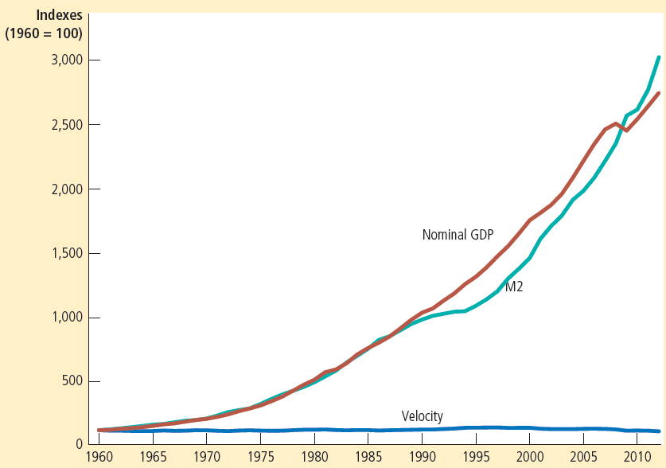

Figure 3
Nominal GDP, the Quantity of Money, and the Velocity of Money
This figure shows the nominal value of output as measured by nominal GDP, the quantity of money as measured by M2, and the velocity of money as measured by their ratio. For comparability, all three series have been scaled to equal 100 in 1960. Notice that nominal GDP and the quantity of money have grown dramatically over this period, while velocity has been relatively stable.
© 2015 Cengage Learning. All Rights Reserved. May not be copied, scanned, or duplicated, in whole or in part, except for use as permitted in a license distributed with a certain product or service or otherwise on a password-protected website for classroom use.

Slide 19
Quantity Theory of Money
Velocity of money
  Relatively stable over time
Changes in quantity of money, M
  Proportionate changes in nominal value of output (P × Y)
Economy’s output of goods & services, Y
  Primarily determined by factor supplies
  And available production technology
  Money does not affect output
© 2015 Cengage Learning. All Rights Reserved. May not be copied, scanned, or duplicated, in whole or in part, except for use as permitted in a license distributed with a certain product or service or otherwise on a password-protected website for classroom use.

Slide 20
Quantity Theory of Money
Change in money supply, M
  Induces proportional changes in the nominal value of output (P × Y)
    Reflected in changes in the price level (P)
When the central bank increases the money supply rapidly
  High rate of inflation
© 2015 Cengage Learning. All Rights Reserved. May not be copied, scanned, or duplicated, in whole or in part, except for use as permitted in a license distributed with a certain product or service or otherwise on a password-protected website for classroom use.

Slide 21
Money and prices during four hyperinflations
Hyperinflation
  Inflation that exceeds 50% per month
  The price level increases more than a hundredfold over the course of a year
Data on hyperinflation
  Clear link between quantity of money and the price level
© 2015 Cengage Learning. All Rights Reserved. May not be copied, scanned, or duplicated, in whole or in part, except for use as permitted in a license distributed with a certain product or service or otherwise on a password-protected website for classroom use.

Slide 22
Money and prices during four hyperinflations
Four classic hyperinflation, 1920s
  Austria, Hungary, Germany, and Poland
  Slope of the money line
    Rate at which the quantity of money was growing
  Slope of the price line: inflation rate
  The steeper the lines: the higher the rates of money growth or inflation
Prices rise when the government prints too much money
© 2015 Cengage Learning. All Rights Reserved. May not be copied, scanned, or duplicated, in whole or in part, except for use as permitted in a license distributed with a certain product or service or otherwise on a password-protected website for classroom use.

Slide 23
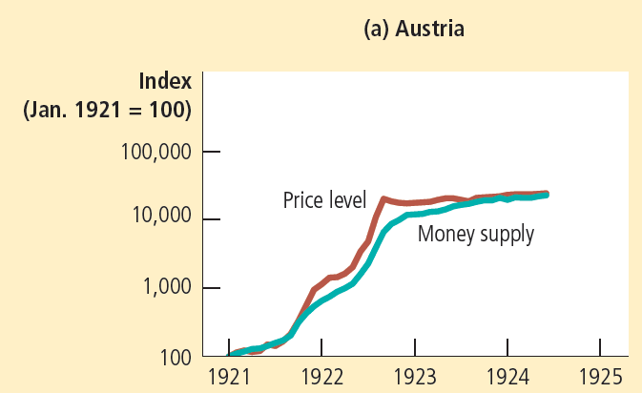

Figure 4
Money and Prices during Four Hyperinflations
This figure shows the quantity of money and the price level during four hyperinflations. (Note that these variables are graphed on logarithmic scales. This means that equal vertical distances on the graph represent equal percentage changes in the variable.) In each case, the quantity of money and the price level move closely together. The strong association between these two variables is consistent with the quantity theory of money, which states that growth in the money supply is the primary cause of inflation.
© 2015 Cengage Learning. All Rights Reserved. May not be copied, scanned, or duplicated, in whole or in part, except for use as permitted in a license distributed with a certain product or service or otherwise on a password-protected website for classroom use.

Slide 24
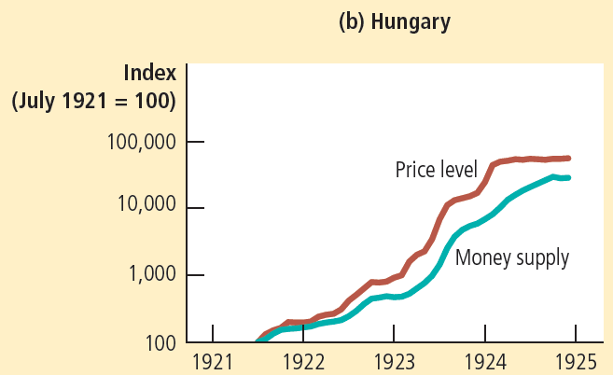
Figure 4
Money and Prices during Four Hyperinflations
This figure shows the quantity of money and the price level during four hyperinflations. (Note that these variables are graphed on logarithmic scales. This means that equal vertical distances on the graph represent equal percentage changes in the variable.) In each case, the quantity of money and the price level move closely together. The strong association between these two variables is consistent with the quantity theory of money, which states that growth in the money supply is the primary cause of inflation.
© 2015 Cengage Learning. All Rights Reserved. May not be copied, scanned, or duplicated, in whole or in part, except for use as permitted in a license distributed with a certain product or service or otherwise on a password-protected website for classroom use.

Slide 25
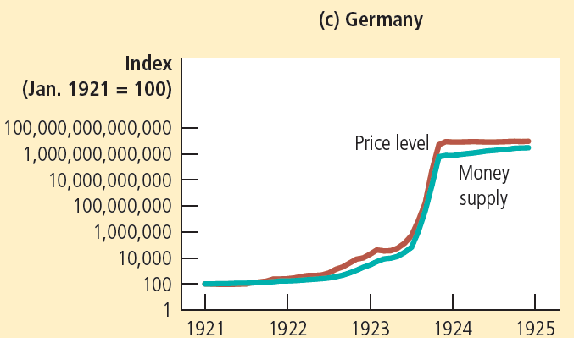
Figure 4
Money and Prices during Four Hyperinflations
This figure shows the quantity of money and the price level during four hyperinflations. (Note that these variables are graphed on logarithmic scales. This means that equal vertical distances on the graph represent equal percentage changes in the variable.) In each case, the quantity of money and the price level move closely together. The strong association between these two variables is consistent with the quantity theory of money, which states that growth in the money supply is the primary cause of inflation.
© 2015 Cengage Learning. All Rights Reserved. May not be copied, scanned, or duplicated, in whole or in part, except for use as permitted in a license distributed with a certain product or service or otherwise on a password-protected website for classroom use.

Slide 26
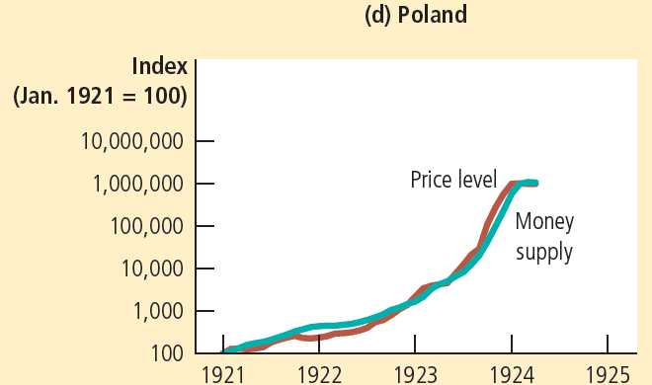
Figure 4
Money and Prices during Four Hyperinflations
This figure shows the quantity of money and the price level during four hyperinflations. (Note that these variables are graphed on logarithmic scales. This means that equal vertical distances on the graph represent equal percentage changes in the variable.) In each case, the quantity of money and the price level move closely together. The strong association between these two variables is consistent with the quantity theory of money, which states that growth in the money supply is the primary cause of inflation.
© 2015 Cengage Learning. All Rights Reserved. May not be copied, scanned, or duplicated, in whole or in part, except for use as permitted in a license distributed with a certain product or service or otherwise on a password-protected website for classroom use.

Slide 27
The Inflation Tax
The inflation tax
  Revenue the government raises by creating (printing) money
  Tax on everyone who holds money
    When the government prints money
    The price level rises
    And the dollars in your wallet are less valuable
© 2015 Cengage Learning. All Rights Reserved. May not be copied, scanned, or duplicated, in whole or in part, except for use as permitted in a license distributed with a certain product or service or otherwise on a password-protected website for classroom use.

Slide 28
The Fisher Effect
Principle of monetary neutrality
  An increase in the rate of money growth
  Raises the rate of inflation
  But does not affect any real variable
Real interest rate = Nominal interest rate – Inflation rate
Nominal interest rate = Real interest rate + Inflation rate
© 2015 Cengage Learning. All Rights Reserved. May not be copied, scanned, or duplicated, in whole or in part, except for use as permitted in a license distributed with a certain product or service or otherwise on a password-protected website for classroom use.

Slide 29
The Fisher Effect
Fisher effect
  One-for-one adjustment of nominal interest rate to inflation rate
  When the Fed increases the rate of money growth
  Long-run result
    Higher inflation rate
    Higher nominal interest rate
© 2015 Cengage Learning. All Rights Reserved. May not be copied, scanned, or duplicated, in whole or in part, except for use as permitted in a license distributed with a certain product or service or otherwise on a password-protected website for classroom use.

Slide 30
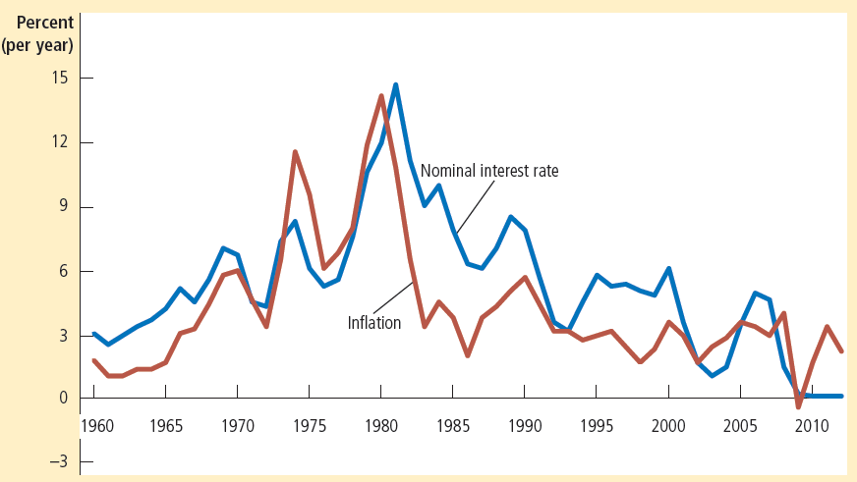

Figure 5
The Nominal Interest Rate and the Inflation Rate
This figure uses annual data since 1960 to show the nominal interest rate on three-month Treasury bills and the inflation rate as measured by the consumer price index. The close association between these two variables is evidence for the Fisher effect: When the inflation rate rises, so does the nominal interest rate.
© 2015 Cengage Learning. All Rights Reserved. May not be copied, scanned, or duplicated, in whole or in part, except for use as permitted in a license distributed with a certain product or service or otherwise on a password-protected website for classroom use.

Slide 31
The Costs of Inflation
Inflation fallacy
  “Inflation robs people of the purchasing power of his hard-earned dollars”
When prices rise
  Buyers pay more
  Sellers get more
Inflation does not in itself reduce people’s real purchasing power
© 2015 Cengage Learning. All Rights Reserved. May not be copied, scanned, or duplicated, in whole or in part, except for use as permitted in a license distributed with a certain product or service or otherwise on a password-protected website for classroom use.

Slide 32
The Costs of Inflation
Shoeleather costs
  Resources wasted when inflation encourages people to reduce their money holdings
  Can be substantial
Menu costs
  Costs of changing prices
  Inflation – increases menu costs that firms must bear
© 2015 Cengage Learning. All Rights Reserved. May not be copied, scanned, or duplicated, in whole or in part, except for use as permitted in a license distributed with a certain product or service or otherwise on a password-protected website for classroom use.

Slide 33
Relative-Price Variability
Market economies
  Relative prices allocate scarce resources
  Consumers compare quality and prices of various goods and services
    Determine allocation of scarce factors of production
  Inflation distorts relative prices
    Consumer decisions are distorted
    Markets are less able to allocate resources to their best use
© 2015 Cengage Learning. All Rights Reserved. May not be copied, scanned, or duplicated, in whole or in part, except for use as permitted in a license distributed with a certain product or service or otherwise on a password-protected website for classroom use.

Slide 34
Inflation-Induced Tax Distortions
Taxes distort incentives
  Many taxes: more problematic in the presence of inflation
Tax treatment of capital gains
  Capital gains are profits
    Sell an asset for more than its purchase price
  Inflation discourages saving
    Exaggerates the size of capital gains
    Increases the tax burden
© 2015 Cengage Learning. All Rights Reserved. May not be copied, scanned, or duplicated, in whole or in part, except for use as permitted in a license distributed with a certain product or service or otherwise on a password-protected website for classroom use.

Slide 35
Inflation-Induced Tax Distortions
Tax treatment of interest income
  Nominal interest earned on savings
    Treated as income
    Even though part of the nominal interest rate compensates for inflation
Higher inflation
  Tends to discourage people from saving
© 2015 Cengage Learning. All Rights Reserved. May not be copied, scanned, or duplicated, in whole or in part, except for use as permitted in a license distributed with a certain product or service or otherwise on a password-protected website for classroom use.

Slide 36
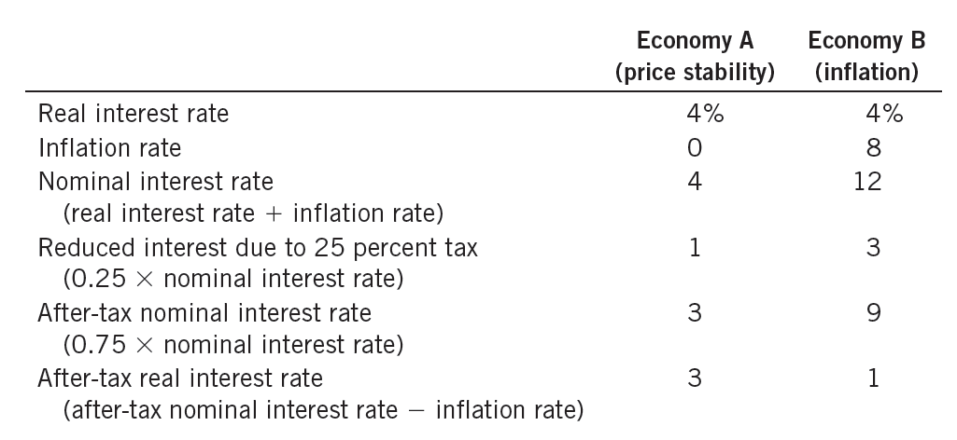
Table 1
How Inflation Raises the Tax Burden on Saving
In the presence of zero inflation, a 25 percent tax on interest income reduces the real interest rate from 4 percent to 3 percent. In the presence of 8 percent inflation, the same tax reduces the real interest rate from 4 percent to 1 percent.
© 2015 Cengage Learning. All Rights Reserved. May not be copied, scanned, or duplicated, in whole or in part, except for use as permitted in a license distributed with a certain product or service or otherwise on a password-protected website for classroom use.

Slide 37
Confusion and Inconvenience
Money
  Yardstick with which we measure economic transactions
The Fed’s job
  Ensure the reliability of money
When the Fed increases money supply
  Creates inflation
  Erodes the real value of the unit of account
© 2015 Cengage Learning. All Rights Reserved. May not be copied, scanned, or duplicated, in whole or in part, except for use as permitted in a license distributed with a certain product or service or otherwise on a password-protected website for classroom use.

Slide 38
Arbitrary Redistributions of Wealth
Unexpected inflation
  Redistributes wealth among the population
    Not by merit
    Not by need
  Redistribute wealth among debtors and creditors
Inflation: volatile and uncertain
  When the average rate of inflation is high
© 2015 Cengage Learning. All Rights Reserved. May not be copied, scanned, or duplicated, in whole or in part, except for use as permitted in a license distributed with a certain product or service or otherwise on a password-protected website for classroom use.

Slide 39
Deflation May Be Worse
Small and predictable amount of deflation
  May be desirable
The Friedman rule: moderate deflation will
  Lower the nominal interest rate
  Reduce the cost of holding money
  Shoeleather costs of holding money - minimized by a nominal interest rate close to zero
    Deflation equal to the real interest rate
© 2015 Cengage Learning. All Rights Reserved. May not be copied, scanned, or duplicated, in whole or in part, except for use as permitted in a license distributed with a certain product or service or otherwise on a password-protected website for classroom use.

Slide 40
Deflation May Be Worse
Costs of deflation
  Menu costs
  Relative-price variability
  If not steady and predictable
    Redistribution of wealth toward creditors and away from debtors
  Arises because of broader macroeconomic difficulties
    Symptom of deeper economic problems
© 2015 Cengage Learning. All Rights Reserved. May not be copied, scanned, or duplicated, in whole or in part, except for use as permitted in a license distributed with a certain product or service or otherwise on a password-protected website for classroom use.

Slide 41
The wizard of oz and the free-silver debate
Movie The Wizard of Oz
  Based on a children’s book, 1900
  Allegory about U.S. monetary policy in the late 19th century
1880-1896, price level fell by 23%
  Major redistribution of wealth
  Farmers in west were debtors
  Bankers in east were creditors
  Real value of debts increased
© 2015 Cengage Learning. All Rights Reserved. May not be copied, scanned, or duplicated, in whole or in part, except for use as permitted in a license distributed with a certain product or service or otherwise on a password-protected website for classroom use.

Slide 42
The wizard of oz and the free-silver debate
Possible solution to the farmers’ problem
  Free coinage of silver
  During the gold standard
Quantity of gold determined
  Money supply
  Price level
© 2015 Cengage Learning. All Rights Reserved. May not be copied, scanned, or duplicated, in whole or in part, except for use as permitted in a license distributed with a certain product or service or otherwise on a password-protected website for classroom use.

Slide 43
The wizard of oz and the free-silver debate
Free-silver advocates
  Silver and gold - to be used as money
  Increase money supply
  Pushed up the price level
  Reduced real burden of the farmers’ debts
© 2015 Cengage Learning. All Rights Reserved. May not be copied, scanned, or duplicated, in whole or in part, except for use as permitted in a license distributed with a certain product or service or otherwise on a password-protected website for classroom use.

Slide 44
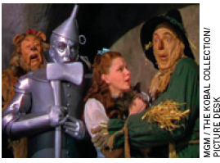
The wizard of oz and the free-silver debate
L. Frank Baum
  Author of the book The Wonderful Wizard of Oz
  Midwestern journalist
Characters
  Protagonists in the major political battle of his time
An early debate over monetary policy
© 2015 Cengage Learning. All Rights Reserved. May not be copied, scanned, or duplicated, in whole or in part, except for use as permitted in a license distributed with a certain product or service or otherwise on a password-protected website for classroom use.

Slide 45
The wizard of oz and the free-silver debate
Characters
  Dorothy: Traditional American values
  Toto: Prohibitionist party, also called the Teetotalers
  Scarecrow: Farmers
  Tin Woodsman: Industrial workers
  Cowardly Lion: William Jennings Bryan - prominent advocate of free silver
  Munchkins: Citizens of the East (creditors)
  Wicked Witch of the East: Grover Cleveland
© 2015 Cengage Learning. All Rights Reserved. May not be copied, scanned, or duplicated, in whole or in part, except for use as permitted in a license distributed with a certain product or service or otherwise on a password-protected website for classroom use.

Slide 46
The wizard of oz and the free-silver debate
Characters
  Wicked Witch of the West: William McKinley (1896 president; gold standard)
  Wizard: Marcus Alonzo Hanna, chairman of the Republican Party
  Oz: Abbreviation for ounce of gold
  Yellow Brick Road: Gold standard
Dorothy finds her way home
  Not by just following the yellow brick road
  Magical power of her silver slippers
© 2015 Cengage Learning. All Rights Reserved. May not be copied, scanned, or duplicated, in whole or in part, except for use as permitted in a license distributed with a certain product or service or otherwise on a password-protected website for classroom use.

Slide 47
The wizard of oz and the free-silver debate
Populists
  Lost the debate over the free coinage of silver
  Get the monetary expansion and inflation that they wanted
    Increased supply of gold
      New discoveries - Klondike River in the Canadian Yukon
      Mines of South Africa
  Money supply and price level started to rise
© 2015 Cengage Learning. All Rights Reserved. May not be copied, scanned, or duplicated, in whole or in part, except for use as permitted in a license distributed with a certain product or service or otherwise on a password-protected website for classroom use.

